Slide 1
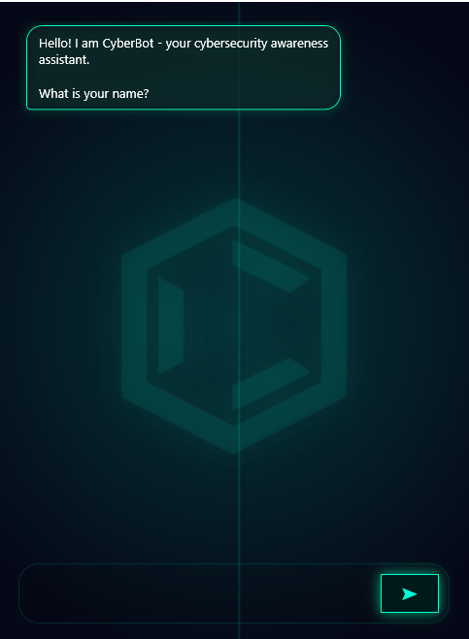
CyberBot
Code Walkthrough
How the bot works — classes, collections,
delegates, error handling and memory
C# .NET
WPF GUI
Delegates
Generics
Error Handling
CYBERBOT · GUI APPLICATION · C# .NET

Slide 2
Project Structure
Two projects, one solution — console logic linked to the WPF GUI via a shared namespace
Program.cs
MemoryStore.cs
Main entry point — calls all original console classes
Static Dictionary — stores name, topic, message count
VoiceGreeting.cs
SentimentDetector.cs
SpeechSynthesizer — male voice welcome on startup
Detects user emotion — prepends empathy prefix to response
AsciiArt.cs
ResponseLibrary.cs
Animated lock ASCII art with Thread.Sleep stagger
Static Lists of responses — GetRandom() picks one per call
SectionDivider.cs
ConsoleBridge.cs
Utility — draws a green separator line
Only link between projects — calls VoiceGreeting and Divider
ChatEngine.cs
MainWindow.xaml.cs
Delegates, keyword routing, sentiment, memory, error handling
UI code-behind — AddUserBubble, AddBotBubble, SubmitMessage
CYBERBOT · PROJECT STRUCTURE · 10 FILES

Slide 3
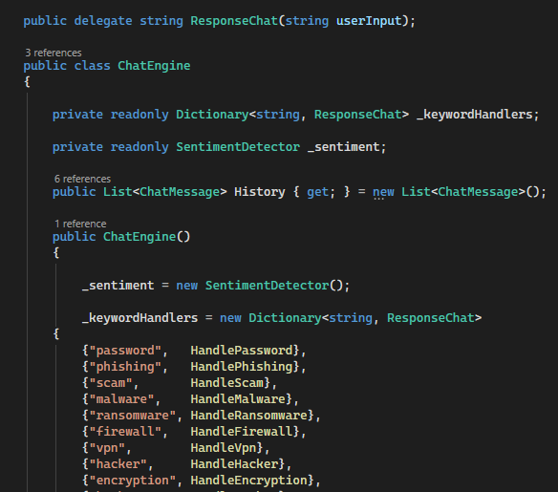
Delegates & Generic Dictionary
The delegate ResponseChat maps each keyword string to a handler method at runtime
What is a delegate?
A delegate is a type-safe function pointer. Instead of hard-coding which method to call, we store method references in a Dictionary and invoke them dynamically when a keyword is matched.
This means adding a new keyword only requires one new dictionary entry — the invocation logic never changes.
Dictionary<string, ResponseChat>
The generic Dictionary maps each keyword string to a ResponseChat delegate instance. When a keyword is found in user input, the matching delegate fires the correct handler.
CYBERBOT · DELEGATES · ChatEngine.cs

Slide 4
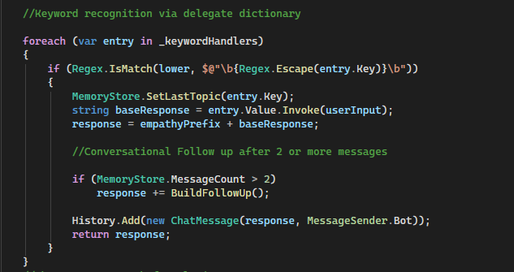
Keyword Recognition
Regex word-boundary matching ensures 'scam' does not match inside 'scenario'
REGEX
Word boundary matching
Regex.IsMatch with \b ensures 'scam' only matches the word 'scam' — not 'scenario' or 'disclaim'.
DELEGATE
entry.Value.Invoke()
The delegate stored in the dictionary is invoked dynamically — no if/else chain needed per keyword.
MEMORY
SetLastTopic()
Every matched keyword is stored in MemoryStore so the bot can reference it in follow-up messages.
FLOW
BuildFollowUp()
After 2+ messages the bot appends a conversational follow-up prompt to keep the dialogue engaging.
CYBERBOT · KEYWORD RECOGNITION · ChatEngine.cs

Slide 5
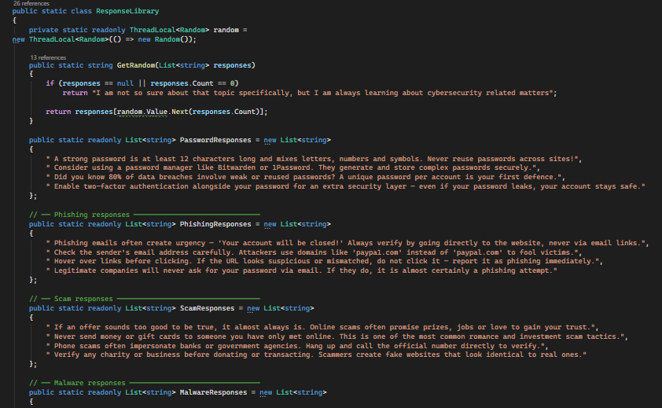
Generic Collections & Random Responses
List<string> holds multiple responses per topic — GetRandom() picks one each time
10
4+
keyword topics
responses each
40+
0%
total responses
repeated answers
Why ThreadLocal<Random>?
A standard static Random is not thread-safe. ThreadLocal<Random> gives each thread its own Random instance — preventing rare race conditions if the bot ever processes multiple inputs concurrently.
CYBERBOT · GENERIC COLLECTIONS · ResponseLibrary.cs

Slide 6
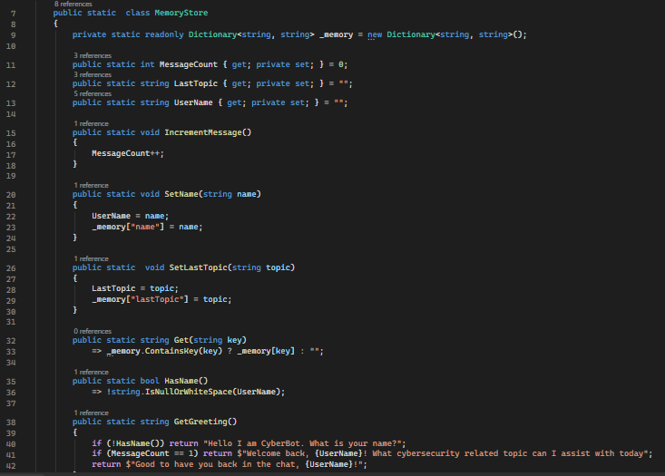
Memory Store
Static Dictionary<string,string> persists user name, last topic and message count across the session
NAME
Extracted via ExtractName() and stored in UserName property and _memory["name"]
TOPIC
SetLastTopic() called every keyword match — used by BuildFollowUp() to personalise follow-ups
COUNT
IncrementMessage() called on every ProcessInput() — triggers follow-up after 2+ messages
GREET
GetGreeting() checks HasName() and MessageCount to return context-aware opening messages
CYBERBOT · MEMORY RECALL · MemoryStore.cs

Slide 7
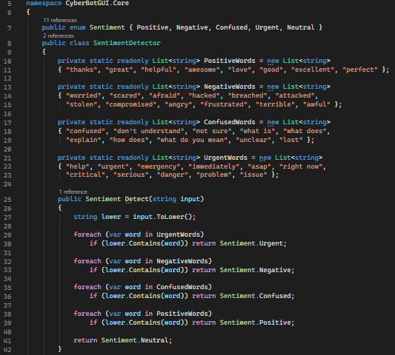
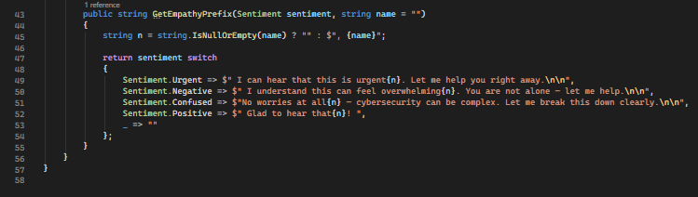
Sentiment Detection & Empathy
Lists of emotional trigger words classify sentiment — an empathy prefix is prepended to the response
Urgent
help, emergency, asap, danger, critical
Negative
worried, scared, hacked, breached, stolen
Confused
confused, explain, what is, how does
Positive
thanks, great, helpful, awesome, perfect
Neutral
No emotional trigger words detected
CYBERBOT · SENTIMENT DETECTION · SentimentDetector.cs

Slide 8
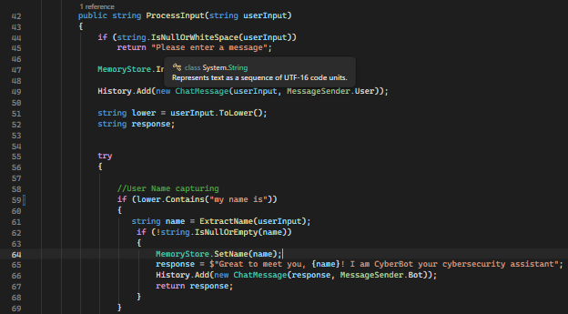
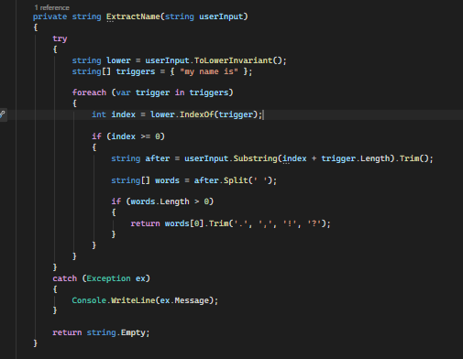
Exception & Error Handling
Every failure path returns a safe message — the bot never crashes on bad input
GUARD 1
Null / whitespace input
IsNullOrWhiteSpace check runs before any logic — returns immediately with a prompt message.
GUARD 2
Short input (<15 chars)
Inputs under 15 characters trigger a clarification response asking the user to elaborate.
GUARD 3
No keyword matched
FallbackResponses List is used when no keyword matches — GetRandom keeps it varied.
TRY/CATCH
Runtime exception caught
The entire ProcessInput body is wrapped in try/catch — ex.Message is returned as a user-friendly string.
SILENT
ExtractName safe catch
Name extraction uses a silent catch — failure returns string.Empty and the conversation continues.
CYBERBOT · ERROR HANDLING · ChatEngine.cs

Slide 9
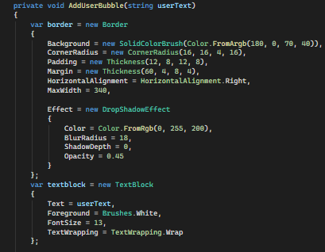
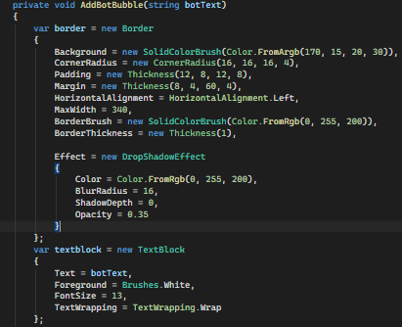
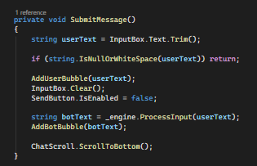
WPF UI — MainWindow.xaml.cs
Chat bubbles built in code-behind using Border and TextBlock — no XAML data binding needed
LAYER
Grid.RowSpan=3 makes the ASCII TextBlock cover the full window behind all UI elements
OPACITY
Opacity=0.07 keeps the lock art subtle — increase to 0.12 for a stronger effect
HITTEST
IsHitTestVisible=False passes all mouse clicks through to the chat controls below
SCROLL
ScrollToBottom() called after every bot bubble so the latest message is always visible
CYBERBOT · WPF UI · MainWindow.xaml.cs

Slide 10
CyberBot
Code Summary
Delegates
Generic Collections
ResponseChat delegate maps 10 keywords to handler methods in a Dictionary<string,ResponseChat>
List<string> per topic, Dictionary<string,string> for memory, List<ChatMessage> for history
Memory Recall
Sentiment + Empathy
Static MemoryStore persists UserName, LastTopic and MessageCount across the entire session
Lists of emotional words classify input — switch expression prepends an empathetic opener
Error Handling
WPF GUI
3 input guards + try/catch wraps all logic — bot always returns a string, never throws to UI
Border + TextBlock bubbles built in code-behind — ASCII lock art layered at Opacity 0.07
CYBERBOT · C# .NET · WPF · CYBERSECURITY AWARENESS

